Slide 1
QPower Quantum Series

Slide 2
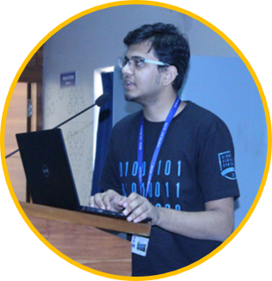
Introduction to Quantum Computing
Syed Farhan Ahmad
Microsoft Student Partner, India

Slide 3
Contents
Classical Computing
Dual Nature of Matter
Quantum Computing
3rd Industrial Revolution
Waves
Qubits
Current age
Particles
Applications

Slide 4
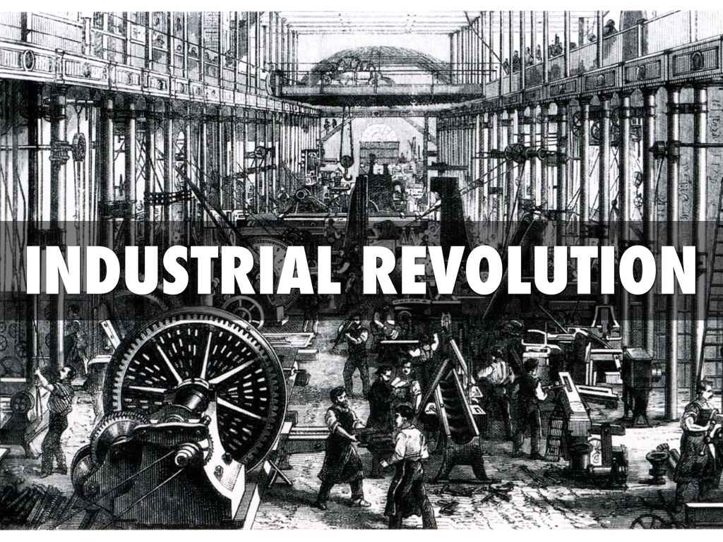
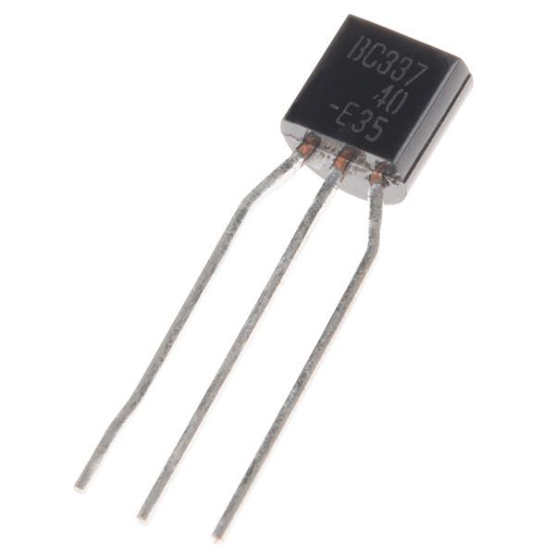
3rd Industrial Revolution
3rd Industrial Revolution

Slide 5


Switches
Transistor as a Switch

Slide 6


Understanding Classical Computers
Bits are building blocks of Classical Computers.
Programmed using Computing Languages for various purposes.
Binary Number System is used for processing and storing Bits.

Slide 7

Diving into Classical Bits
Bits are used to store information.
Classical Computers work with Bits processed by Logic Gates.
Information is processed by a sequence of Bits.
Physical Systems can be implemented into two possible states.

Slide 8

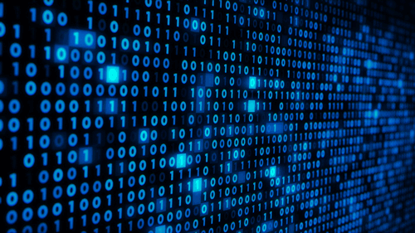
Classical Computing
Classical Computers

Slide 9
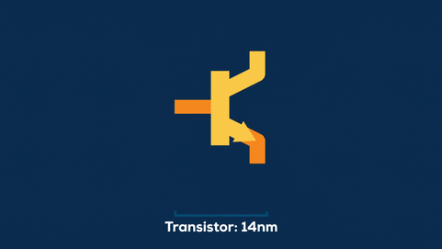
Classical Computing
End of Moore’s Law
Moore's Law states that the number of transistors on a microchip doubles about every two years, though the cost of computers is halved.

Slide 10


What is a Quantum Computer?
Two quantum states define basic unit of information processing known as Qubits.
Computes Qubits as per Quantum Algorithms.
Information is processed and stored in Quantum States of Matter.
Quantum Computing is in a phase which Classical Computing was in 1990s.

Slide 11
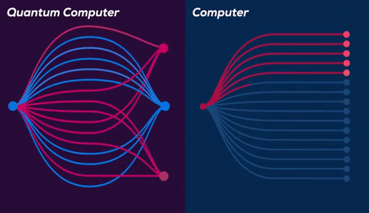
Why is a Quantum Computer better?
Parallelism

Slide 12
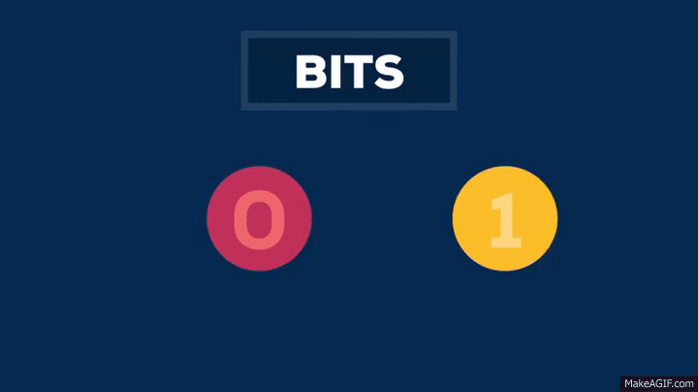
What is a Quantum Computer

Slide 13
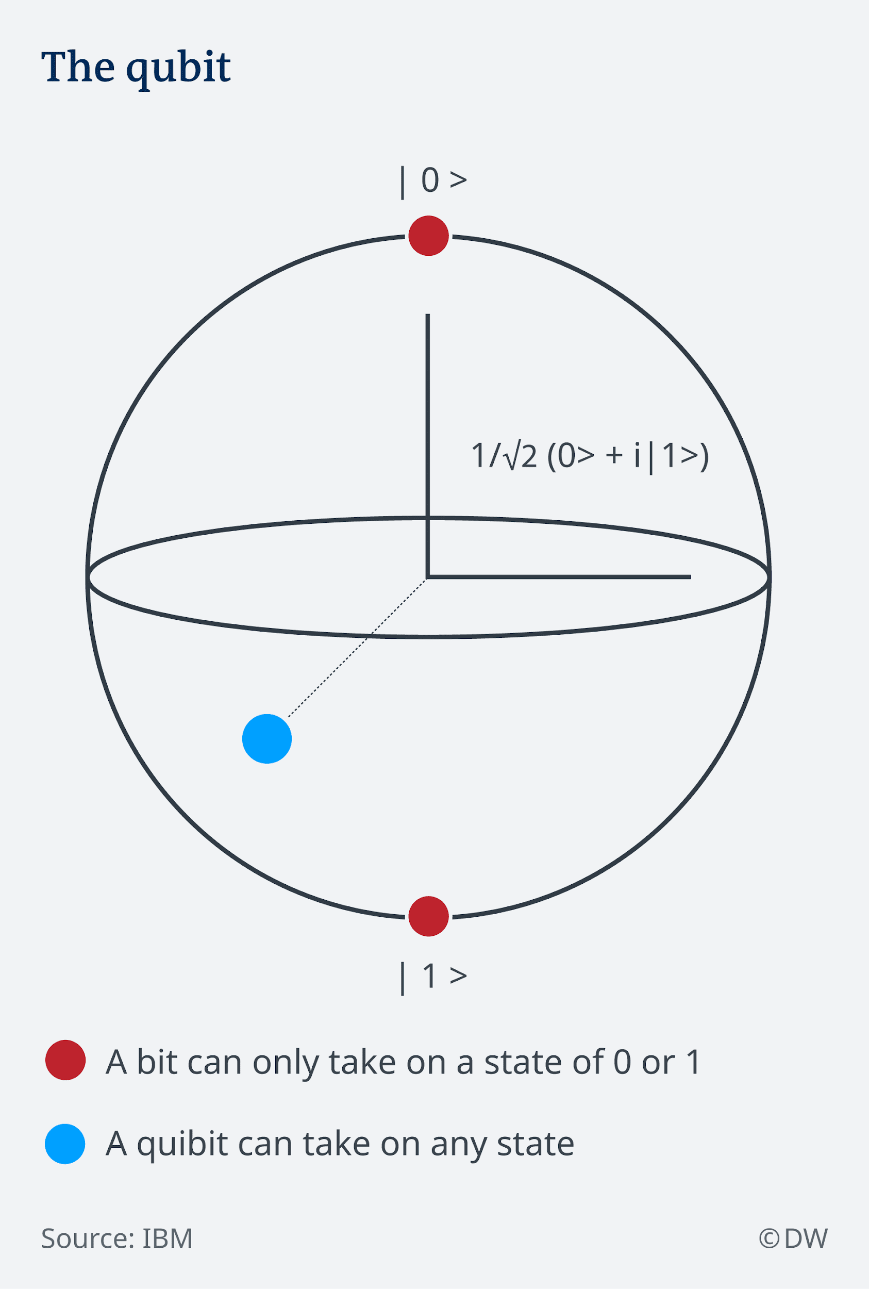
What are Qubits?
Core Component of Quantum Computing.
Exponential Amount of Information can be encoded.
A qubit is a vector of two complex numbers with unit length.
A qubit is inherently probabilistic, meaning that two identical qubits may have different values once measured.

Slide 14
Applications of Quantum Computers

Slide 15
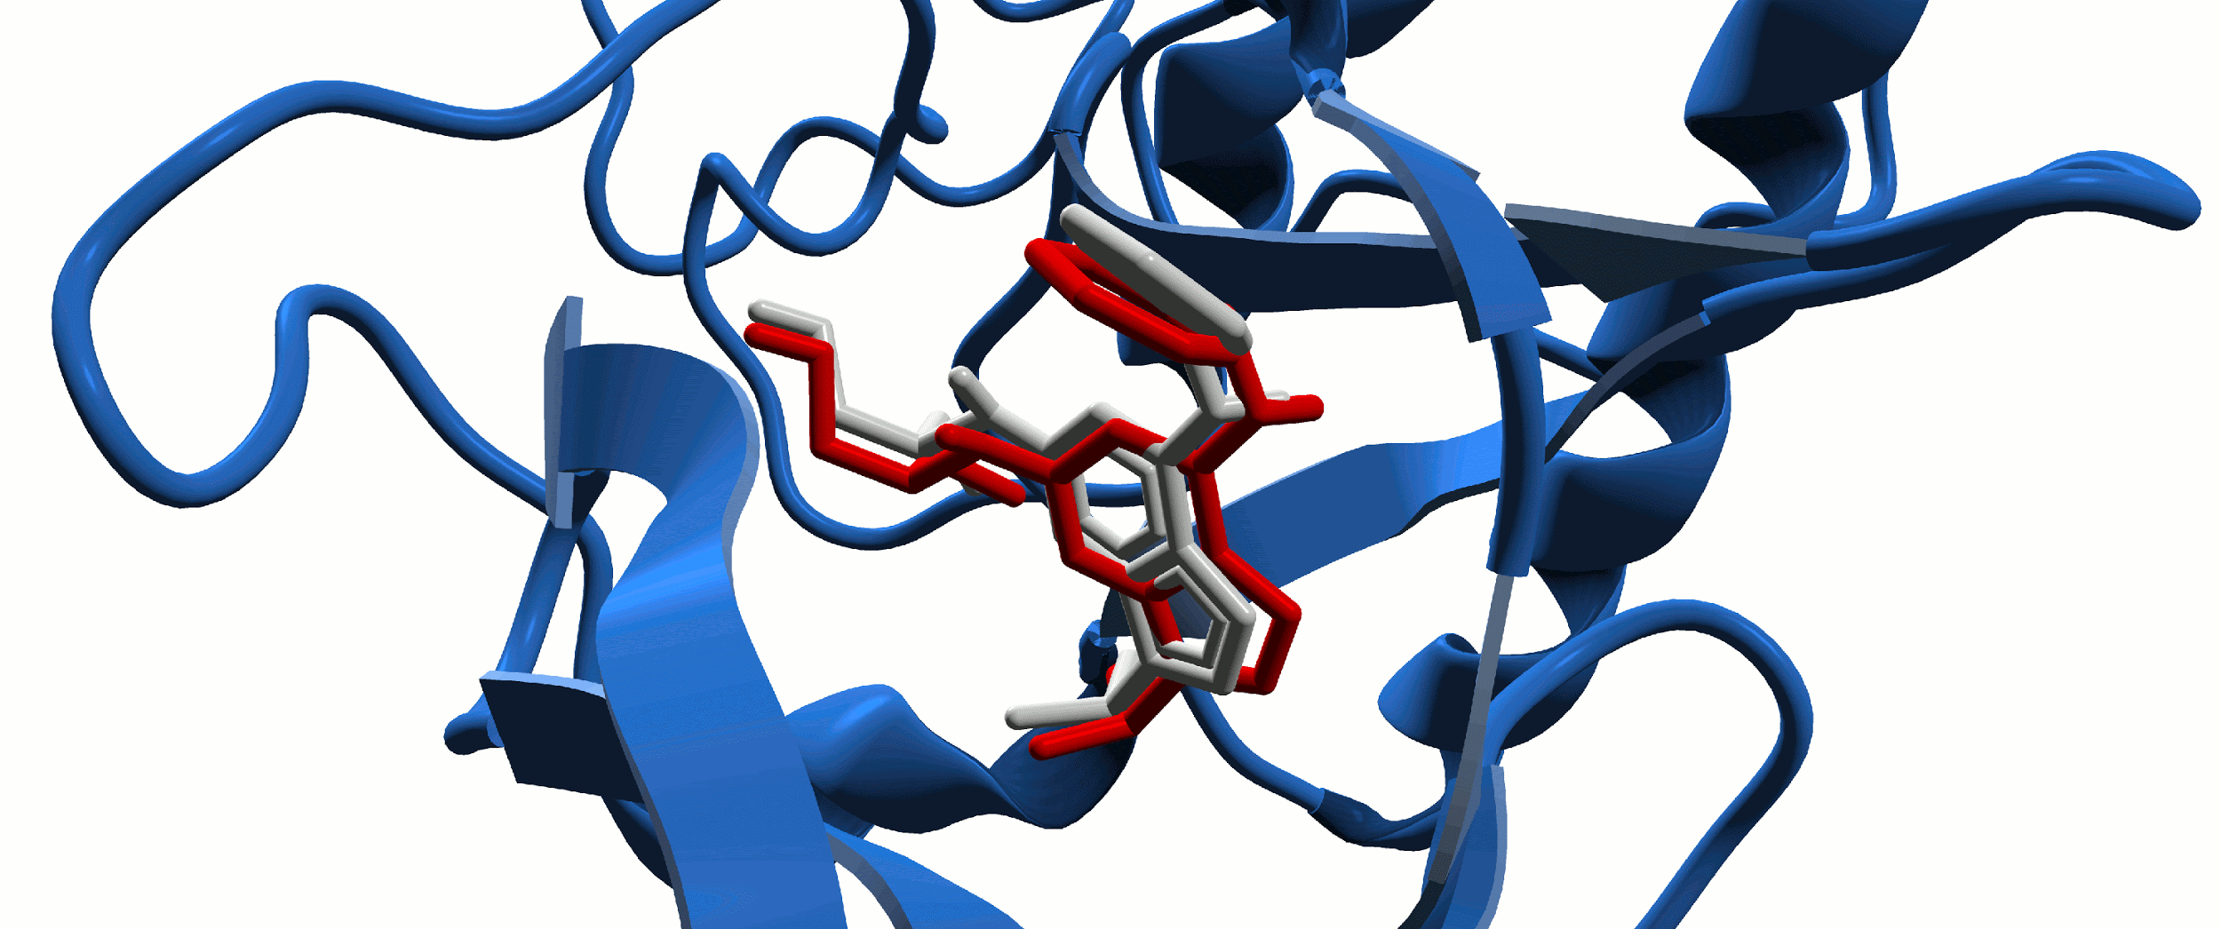
Biochemical Simulations
Molecular Dynamics
Notes:
Live example , molecular biology, etc. gif file

Slide 16
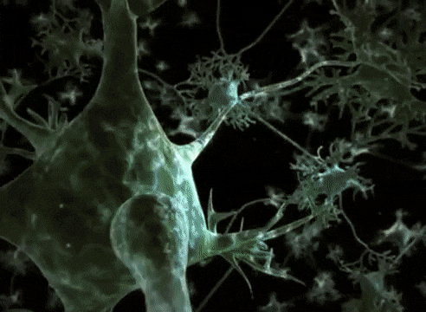
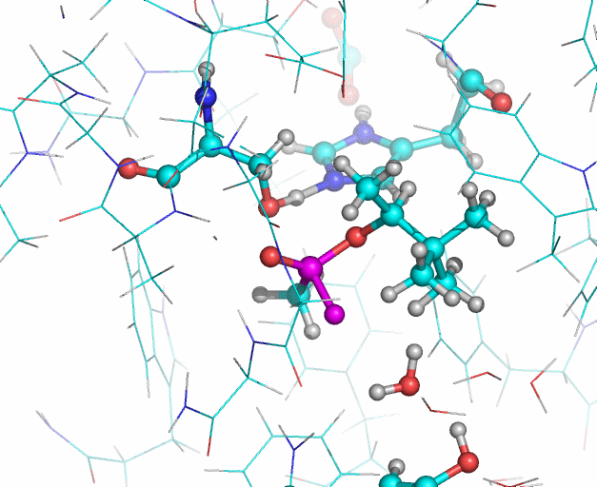
Biochemical Simulations
Human AChE enzyme
Neuron Impulse
AChE Enzyme Interactions
Notes:
Live example , molecular biology, etc. gif file

Slide 17
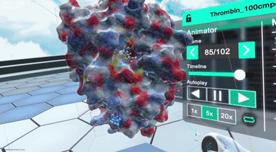
Biochemical Simulations
Drug Discovery- COVID-19??
Nanome’s VR Simulations
Notes:
Live example , molecular biology, etc. gif file

Slide 18
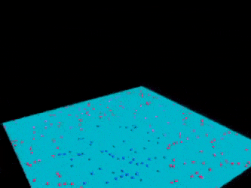
Machine Learning
Machine Learning- SVM
Notes:
Live example , molecular biology, etc. gif file

Slide 19
Dual Nature of Matter

Slide 20
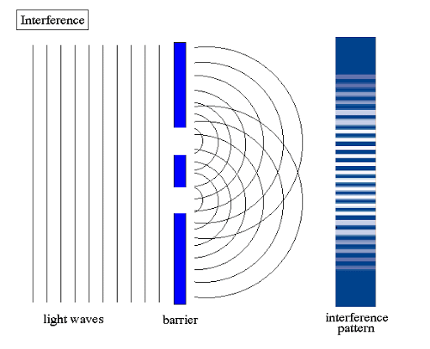
Dual Nature of Matter
Dual Nature of Matter lays the concept of Wave-Particle Duality.
Every Quantum Entity can be either a Particle or a Wave.
Double Slit Experiment explains that Light Particles can be either a Wave or a Particle.

Slide 21
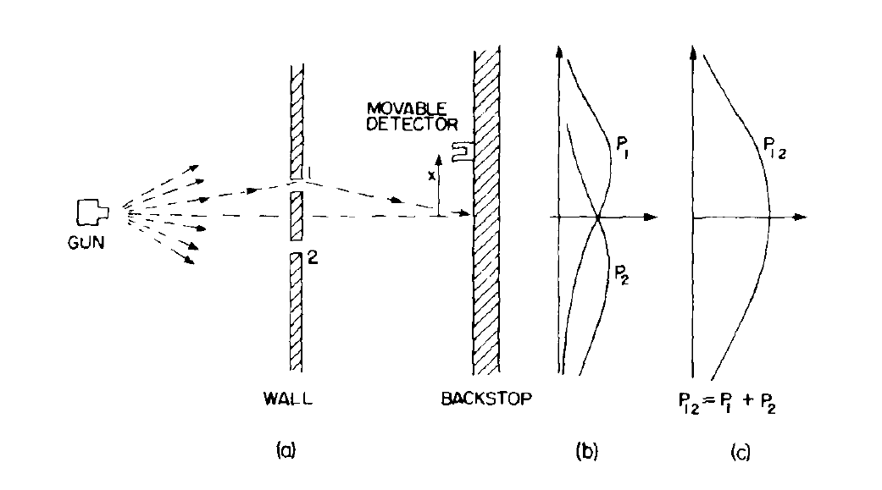
Double Slit Experiment: Case 1
Double Slit Experiment – Particle Nature

Slide 22
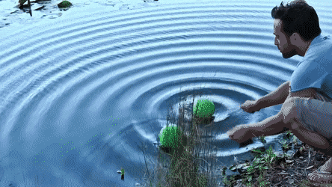
Wave Generator

Slide 23
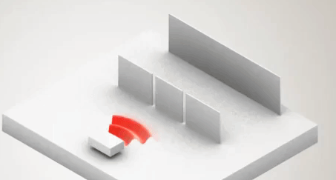
Wave Nature

Slide 24
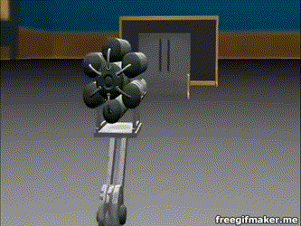
Dual Nature of Matter- electron

Slide 25

What is Third Industrial Revolution?
Proposed by American economist and social theorist Jeremy Rifkin.
Stresses over Renewable Sources of Energy as a medium to a nation’s progress.
Rides on Internet of Things and concepts of Artificial Intelligence.
Transparent and Distributed System.

Slide 26
Need for a Quantum Computer and how they Work?

Slide 27
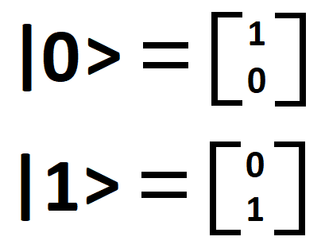
Need for a Quantum Computer
Artificial Intelligence and Quantum Machine Learning.
Cryptography.
Financial and Business Modelling.
Weather Forecasting.
Particle Physics.
Healthcare.

Slide 28
Quantum Supremacy and Dual Nature

Slide 29
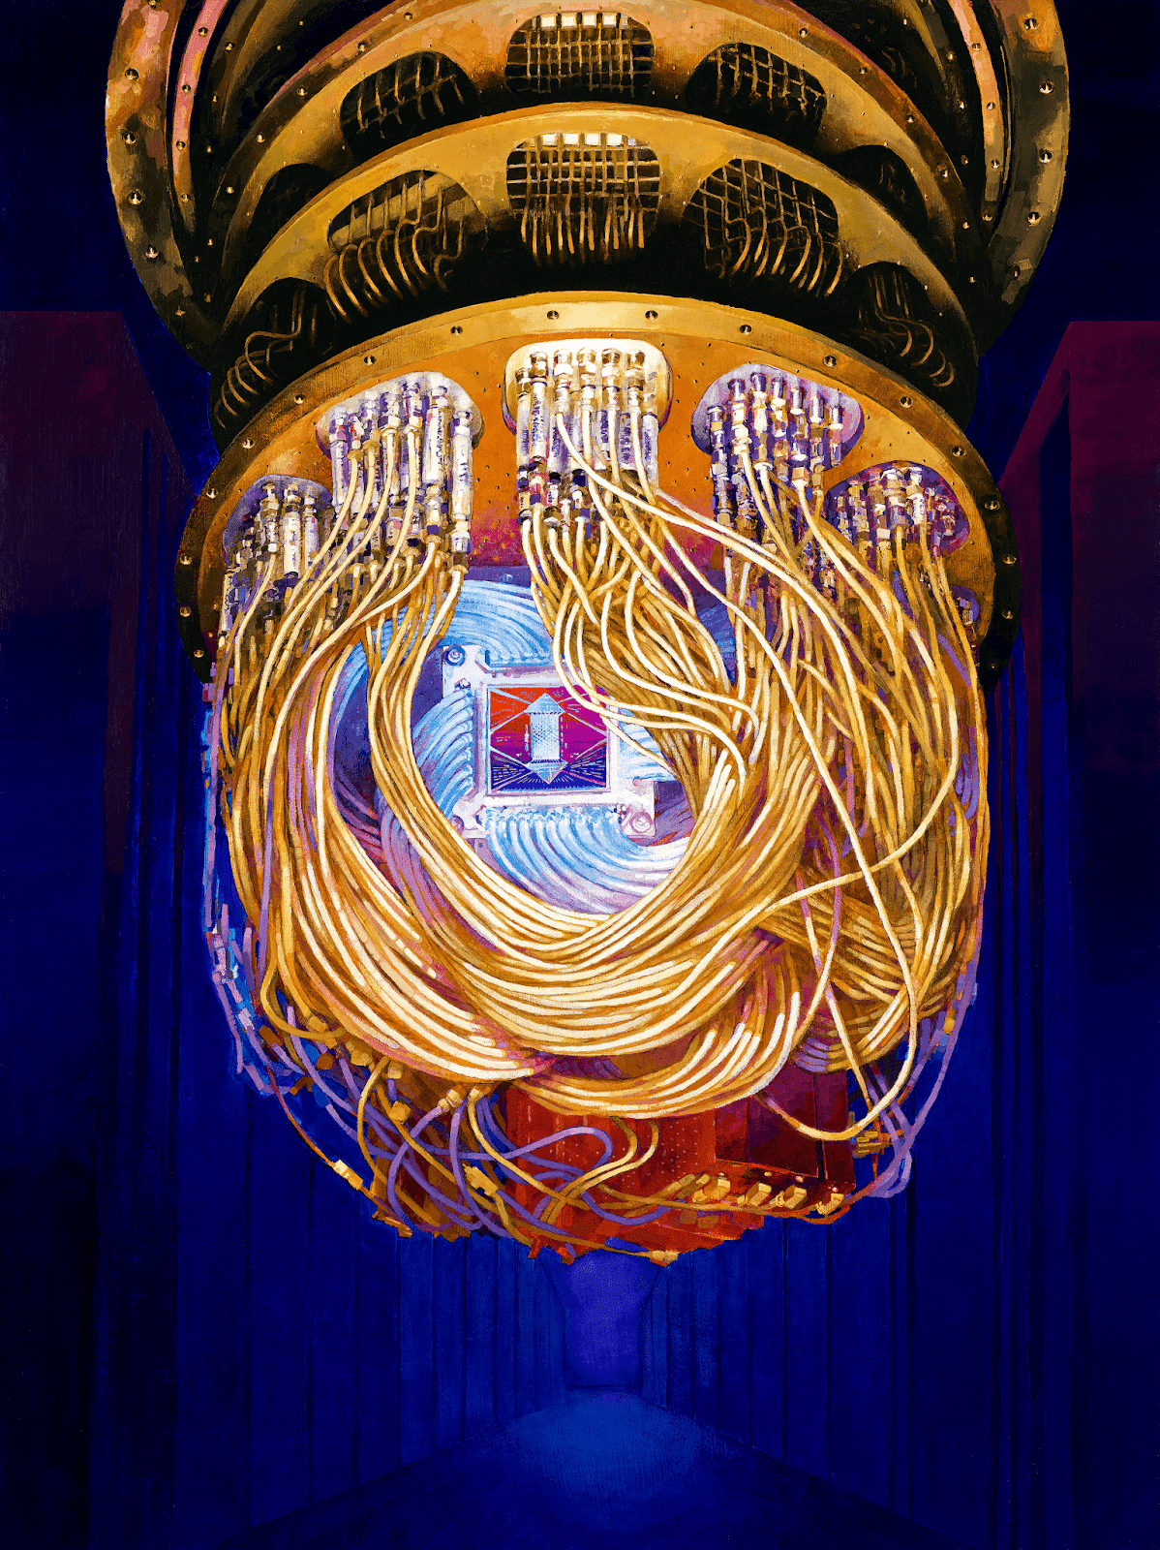
What is Quantum Supremacy?
When a quantum computer finally does something that a classical computer cannot.
Google built a 53-qubit Quantum Computer called Sycamore which can solve a contrived problem in a fraction of second, meaning that for some tasks it can outperform the world's fastest supercomputer, IBM's Summit

Slide 30
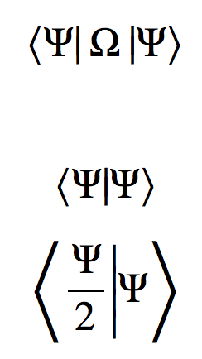
What is Dirac Notation?
Dirac Notation defines two vectors: Bra and Ket Vector.
If ψ is a column vector then we can write it in Dirac notation as | ψ ⟩ , where the | ⋅ ⟩ denotes that it is a ket vector.
Row vector ψ † is henceforth expressed as ⟨ ψ | .

Slide 31

Quantum Information and Gates
Madhav Jivrajani
Co-founder QForest,
PES University, Bangalore

Slide 32
What is computing?
What does it mean to “compute” something?
Does it come at a cost?
Is it a physical process?
Can we quantify the outcome of computing something?

Slide 33
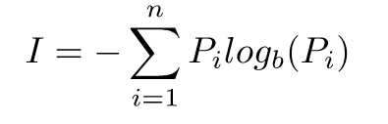
What is computing?
Scary math formula
Shannon’s Equation

Slide 34
What is computing?
Let’s sprinkle some physics on this
Unorganized Organized

Slide 35
Quantum…? Bits…?
Quantum mechanics is as powerful as it is weird. So, how can we use this to our benefit? Much after the advent of quantum mechanics, someone thought, “Oh. What if we use quantum mechanical systems for processing of information?”

Slide 36
Bits! But...quantum?
Classical bits or just bits can have two distinct states, 0 or 1.
Entropy!
Quantum bits on the other hand can be 0 or 1 or anything in-between!
This is possible because of the property of quantum systems called superposition.
Formally… A qubit is a quantum system which represents the smallest unit of quantum information

Slide 37

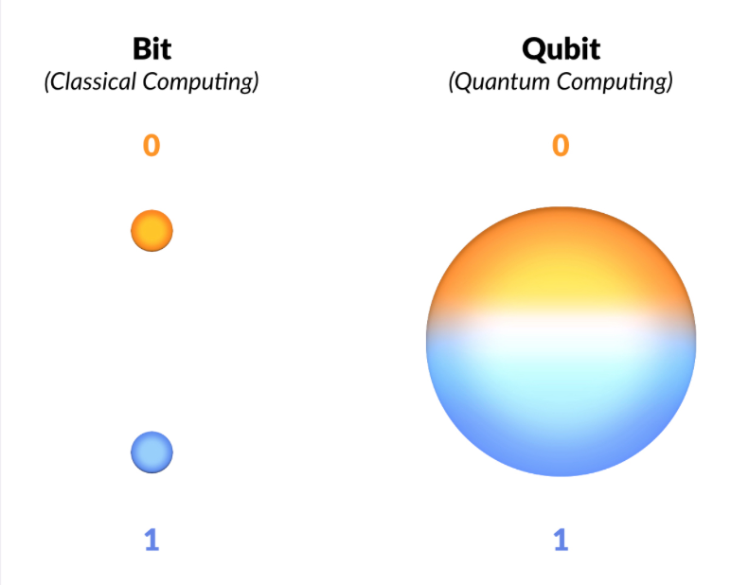
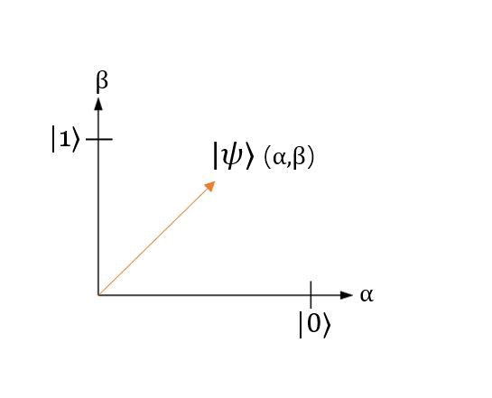
Ohhhh, quantum bits!

Slide 38

Qubits
If you have n qubits then you have 2^{n} computational power
Can any vector be a qubit?

Slide 39
Vectors and Vector Spaces
The generic definition is that, vectors are mathematical objects that have both magnitude and direction.
A vector space over a field F is a set of objects (vectors), where two conditions hold
The operation to add two vectors is closed
The operation of multiplying a vector with a scalar is closed
We represent qubits as “state vectors”
There are simply vectors, no different than the one just presented that point to a specific point in space that corresponds to a particular quantum state. Oftentimes, this is visualized using a Bloch sphere. For instance, a vector, representing the state of a quantum system could look something like this arrow, enclosed inside the Bloch sphere, which is the so-called "state" space of all possible points to which our state vectors can "point"

Slide 40
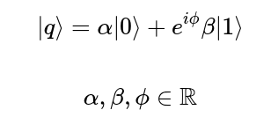

Bloch sphere
Another way to represent a qubit is the bloch sphere representation.
This is a 3D sphere of unit radius and each point on its surface represents a different state.

Slide 41

Wow! That’s quite a lot, you’re almost there!

Slide 42
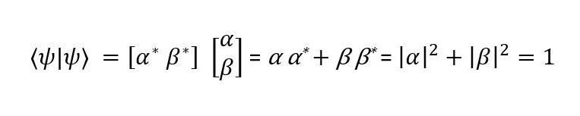
Inner product
Qubits are vectors in a 2^{n} Hilbert space
Geometrically equivalent to the dot product

Slide 43
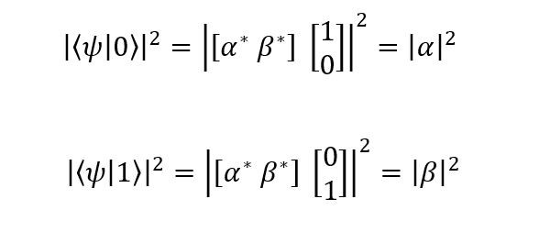
Looking at Schrödinger’s catto 🐈
How do you measure something? And how does this fit in with our trip down physics lane?
The way we measure a qubit in a state|b⟩ is to take the inner product of the qubit with the state in which you want to measure it in and take the modulus of this result and square it.
This gives us the probability that the post-measurement state of the qubit will be |b⟩.

Slide 44
Matrices and why they are important
In linear algebra, think of a matrix as an “operation” that modifies the state of a qubit
Columns of matrices as vectors
Columns are the transformed standard bases when the operation is applied on them
These operations are termed as gates

Slide 45
Gates

Slide 46
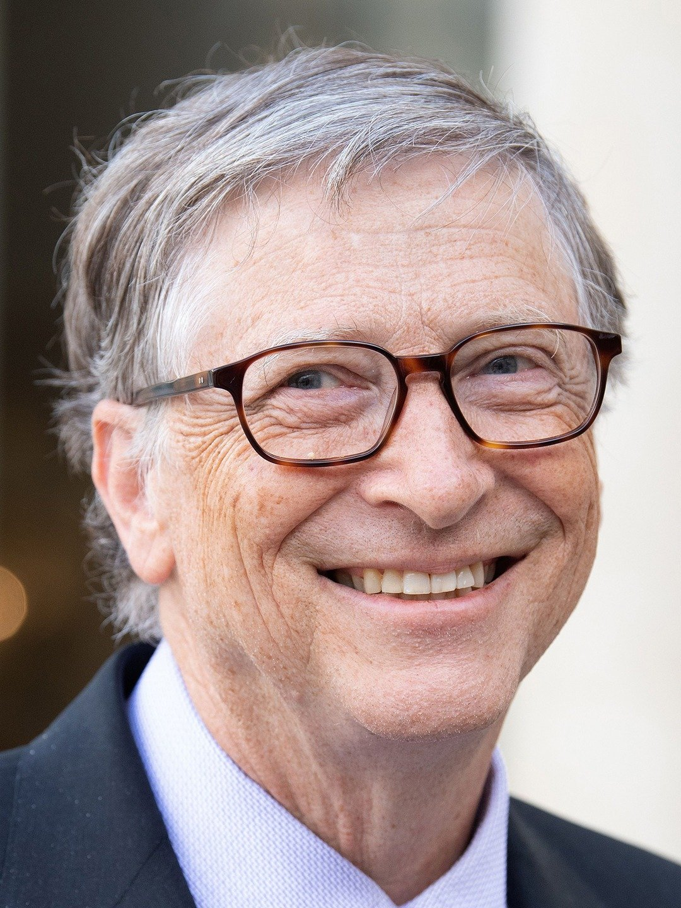
Gates
Hehe, wrong Gates (sorry, was bored)

Slide 47

Classical and quantum gates
What are the differences between the two?
Classical NOT vs classical OR, AND etc
How does it relate to the physics of information?
What are some of the equivalent gates between classical and quantum computing?

Slide 48
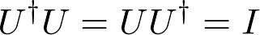
Quantum gates
These are nothing but unitary matrices that change the state of the qubit.

Slide 49
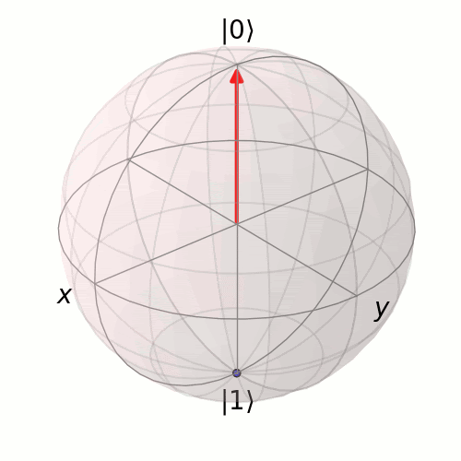
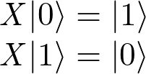
Quantum gates
Pauli X
Equivalent to the classical NOT gate
Flips the standard bases
Has no effect on the Hadamard basis
It rotates the qubit about the X axis on the bloch sphere

Slide 50
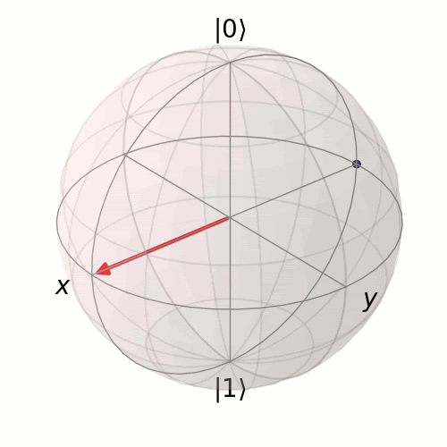
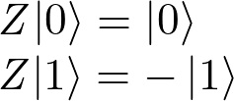
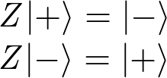
Quantum gates
Pauli Z
Similar to the Pauli X gate, this rotates the qubit vector around the Z axis.
Adds a phase of π

Slide 51
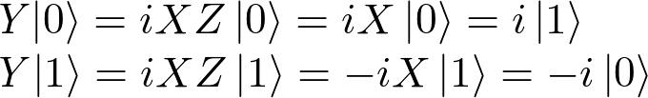

Quantum gates
Pauli Y
Similar to the Pauli X and Z gates, this rotates the qubit vector around the Y axis.
The states obtained by applying Pauli Y to the standard bases are circularly polarized states. |↺⟩,|↻⟩

Slide 52
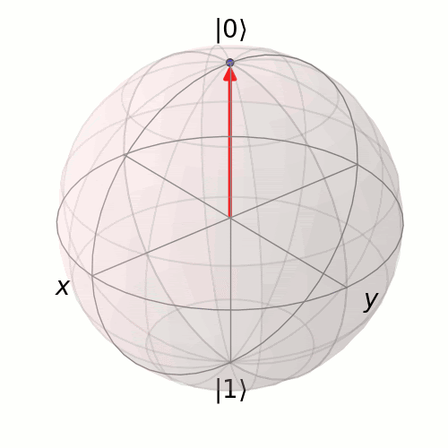
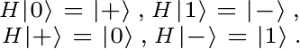
Quantum gates
Hadamard gate
Like, the Paulis, the Hadamard is also a half rotation about the Bloch sphere. However, the difference is that it rotates about an axis that is exactly between the X and the Z axes.

Slide 53
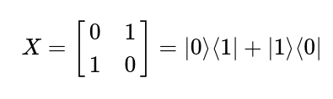
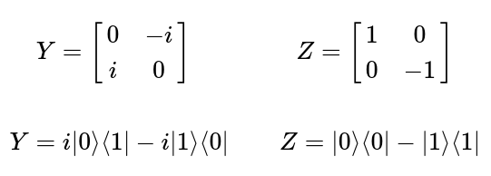
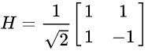
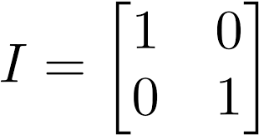
What do they look like?
Matrices!

Slide 54
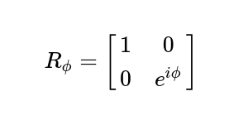
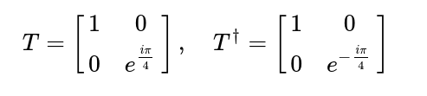
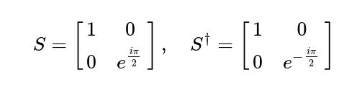
Another easy and cute gate
The R_{ϕ}-gate
Parameterized gate, needs an argument ϕ
The R_{ϕ}-gate performs a rotation of ϕ around the Z-axis
We can derive two more gates from this, T and S

Slide 55
So, how many gates have we covered so far?

Slide 56

So, how many gates have we covered so far?

Slide 57
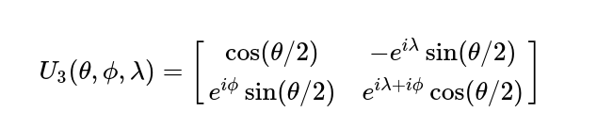
That’s wayyy too many gates to remember!
General, parameterized form of a quantum gate

Slide 58
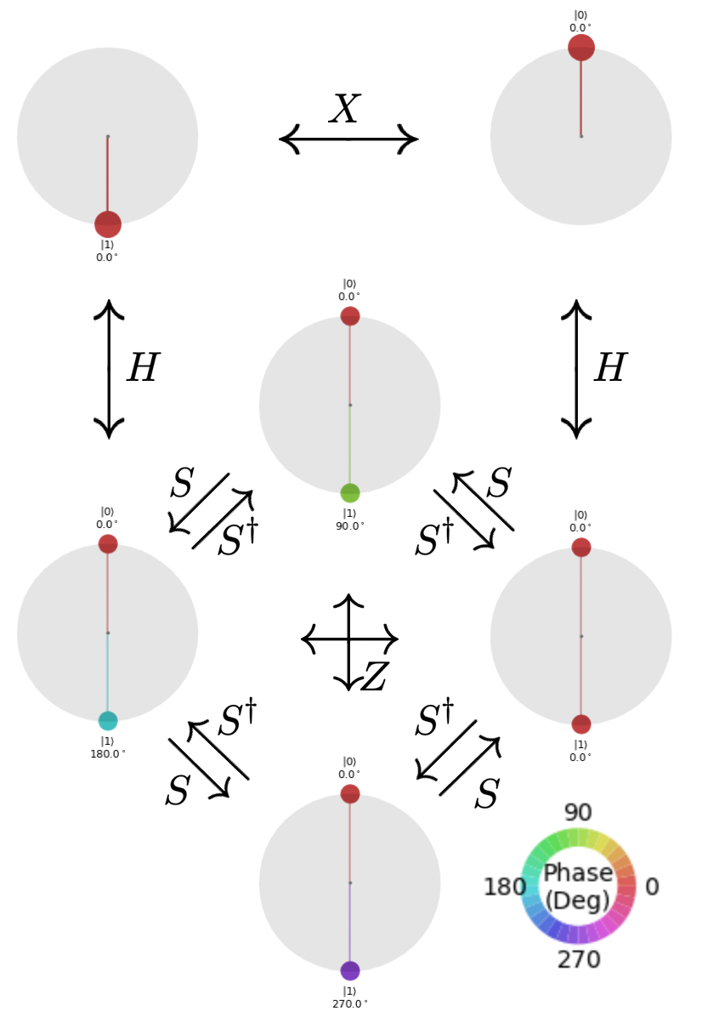
Overview of
single qubit
gate operations

Slide 59
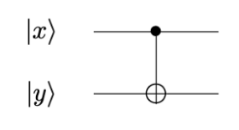
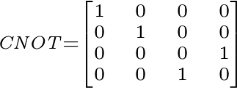
What if I want to perform operations on multiple qubits?
Controlled NOT gate

Slide 60
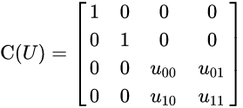
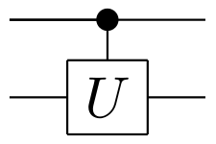
General control gate

Slide 61


Toffoli Gate

Slide 62


Heads or tails?

Slide 63
Rules
The coin starts with heads facing up
The first move is made by your opponent
The second move is made by you
During these moves, neither you nor your opponent can see the coin
The third move is again made by your opponent
In the end, if there’s tails facing up, you win, else your opponent wins!

Slide 64
Finer details
You can either decide to flip the coin or leave it as it is!
But remember, you can’t see the coin!

Slide 65
Finer details
|0⟩ Heads
|1⟩ Tails

Slide 66
Finer details
Flip Pauli X
No Flip Identity

Slide 67

Classical opponent
What happens
if your opponent was
a classical computer?

Slide 68


Quantum opponent

Slide 69
How?
H|0⟩ = |+⟩
H|+⟩ = |0⟩
X|+⟩ = |+⟩
X|0⟩ = |1⟩
I|0⟩ = |0⟩
I|1⟩ = |1⟩

Slide 70

An example
Your opponent flips the coin
You flip the coin
Your opponent decides to leave it as it is
The circuit looks something like this ->

Slide 71

Hadamard, I choose you!
So, this is what your opponent will do if quantum in nature

Slide 72
What is QDK?

Slide 73

Q# is a domain specific programming language built by Microsoft from the ground up to interact with the current and future quantum hardware.
If you're familiar with either C# or F#, you will find Q# familiar to work with as it borrows heavily from those

Slide 74

Introduction to QDK and hands-on code
Pallavi Agrawal

Slide 75

Microsoft's Quantum Development Kit
The QDK comprises a wide range of tools which give developers everything they need to start writing quantum programs
the Q# libraries
The Q# libraries,
Various target machines on which Q# programs can be run
Tools for making work with Q# as seamless as possible
API documentation for pairing Q# with classical host languages such as Python and C#

Slide 76
So what is Microsoft Quantum Katas?
The Microsoft Quantum Katas are a series of self-paced tutorials aimed at teaching elements of quantum computing and Q# programming at the same time.
A testing framework validates your solutions, providing real-time feedback.
https://github.com/Microsoft/QuantumKatas

Slide 77


Slide 78

Introduction to Q#
Rohit Ashiwal

